Slide 1

FINANCIAL PLANNING CYCLE
Zenith Central Bank
Stage 1
Stage 4
Understand your
needs and goals
02
Follow a schedule of
budgeting and stick to it
03
Stage 2
Stage 5
01
Assess your current
financial state
06
Monitor your expenses
and budget
04
Stage 3
Stage 6
05
Create funds essential
to your survival
Refine your budget
as needed

Slide 2
FINANCIAL PLANNING CYCLE
Zenith Central Bank
Stage
1
Stage
2
Stage
3
Stage
4
Stage
5
Stage
6
Understand your
needs and goals
Assess your current
financial state
Create funds essential to
your survival
Follow a schedule of budgeting
and stick to it
Monitor your expenses
and budget
Refine your budget as needed

Slide 3
FINANCIAL PLANNING CYCLE
Zenith Central Bank
Stage 1
Understand your needs and goals
Stage 2
Assess your current financial state
Stage 3
Create funds essential to your survival
Stage 4
Follow a schedule of budgeting and stick to it
Stage 5
Monitor your expenses and budget
Stage 6
Refine your budget as needed

Slide 4






FINANCIAL PLANNING CYCLE
Zenith Central Bank
Stage 4
Stage 2
Stage 6
Follow a schedule of budgeting and stick to it
Assess your current
financial state
Refine your budget as needed
Stage 1
Stage 3
Stage 5
Understand your
needs and goals
Create funds essential to
your survival
Monitor your expenses
and budget

Slide 5
FINANCIAL PLANNING CYCLE
Zenith Central Bank
Stage 1
Understand your needs and goals
Stage 2
Assess your current financial state
Stage 3
Create funds essential to your survival
Stage 4
Follow a schedule of budgeting and stick to it
Stage 5
Monitor your expenses and budget
Stage 6
Refine your budget as needed

Slide 6






FINANCIAL PLANNING CYCLE
Zenith Central Bank
Stage 2
Stage 4
Stage 6
Assess your current financial state
Follow a schedule of budgeting and stick to it
Refine your budget as needed
01
02
03
04
05
06
Stage 1
Stage 3
Stage 5
Understand your
needs and goals
Create funds essential to your survival
Monitor your expenses
and budget

Slide 7
FINANCIAL PLANNING CYCLE
Zenith Central Bank
01
Stage 1
Understand your
needs and goals
06
02
Stage 6
Stage 2
Refine your budget as needed
Assess your current
financial state
05
03
Stage 5
Stage 3
Monitor your expenses
and budget
Create funds essential to your survival
04
Stage 4
Follow a schedule of budgeting and stick to it

Slide 8
FINANCIAL PLANNING CYCLE
Zenith Central Bank
Stage 1 | Stage 2 | Stage 3 | Stage 4 | Stage 5 | Stage 6
Understand your needs and goals | Assess your current financial state | Create funds essential to your survival | Follow a schedule of budgeting and stick to it | Monitor your expenses and budget | Refine your budget as needed
Highlight two or more cells, right-click then choose
"Merge Cells" to organize your table according to your needs!

Slide 9
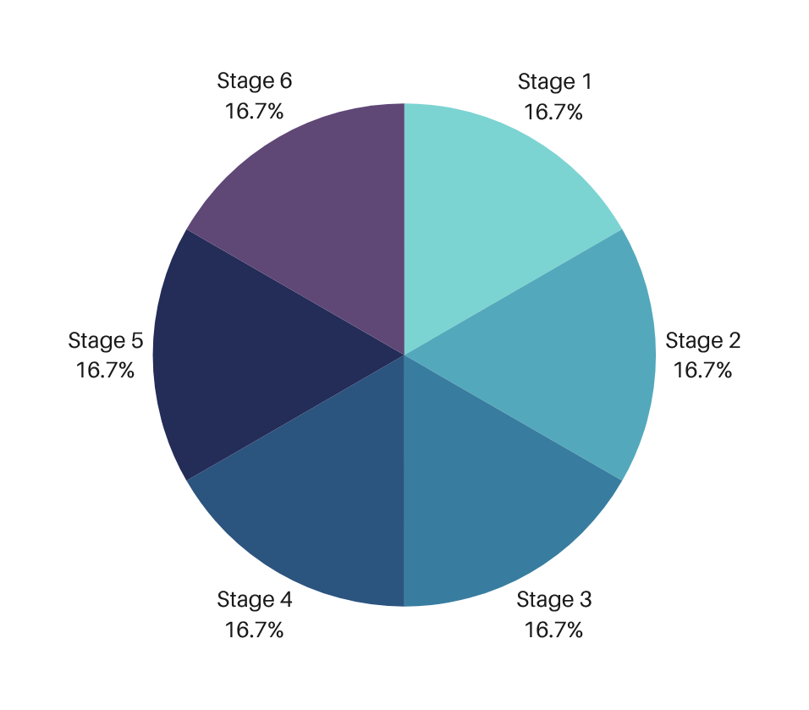
FINANCIAL PLANNING CYCLE
Zenith Central Bank

Slide 10


The Power of Visual Charts
Public Speaking 101
Bring your presentation to the next level

Slide 11

Empower with visual charts
Visual charts make data and numbers on
presentations interesting and memorable.
The Power of Visual Charts
SHARE INFO THAT RESONATES

Slide 12

Simplifies statistics
Advantages of Visual Charts
Use visual charts to communicate
info more effectively.
Easy to understand
Convey a great number of
information in an effective manner
Use visual charts to communicate
info more effectively.
Adds credibility
Use visual charts to communicate
info more effectively.
Makes an impact
Use visual charts to communicate
info more effectively.

Slide 13





Whiteboard Page
Write a note here
Write a note here
Tip: Collaboration makes teamwork easier! Click "Share" and invite your teammates to fill this up. Use this page for bulletins, brainstorms, and other fun team ideas.
Right-click on the background of the slide, or on the thumbnail below, for the option to expand this page into a whiteboard for more space!
Copy a note, drag to the board, and write your ideas.
Copy a note, drag to the board, and write your ideas.

Slide 14
Collaborate on a Whiteboard
Add more sub-ideas
Add a related idea
Add even more sub-ideas
Add more sub-ideas
Add even more sub-ideas
Add a main topic
Add a related idea
Add a related idea
Add even more sub-ideas
Add more sub-ideas
Add a related idea
Add even more sub-ideas
Add more sub-ideas
Tip: Collaboration makes teamwork easier! Click "Share" and invite your teammates to fill this up. Use this page for bulletins, brainstorms, and other fun team ideas.
Right-click on the background of the slide, or on the thumbnail below, for the option to expand this page into a whiteboard for more space!

Slide 15







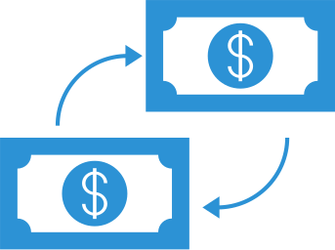
















Resource Page
Find the magic and fun in presenting with Canva Presentations. Press the following keys while on Present mode!
Delete or hide this page before presenting.

Slide 16
Resource Page
Find the magic and fun in presenting with Canva Presentations. Press the following keys while on Present mode!
Delete or hide this page before presenting.

Slide 17
Resource Page
B
C
for blur
for confetti
D
M
for a drumroll
for mic drop
O
Q
for bubbles
for quiet
Find the magic and fun in presenting with Canva Presentations. Press the following keys while on Present mode!
Delete or hide this page before presenting.
U
#
Any number from 0-9
for a timer
for unveil

